Slide 1
Beyond Geometric Path Planning: When Context Matters
Ashesh Jain, Shikhar Sharma
Thorsten Joachims and Ashutosh Saxena

Slide 2
Outline
Motivation
Approach
Context-based score
Feedback mechanism
Learning algorithm
Results

Slide 3
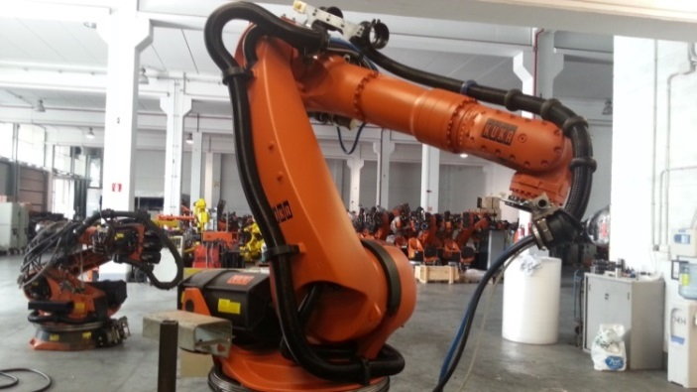
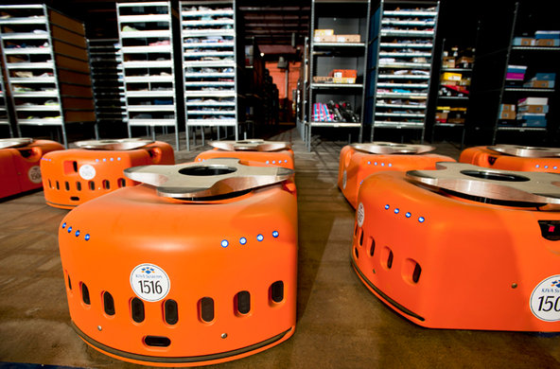
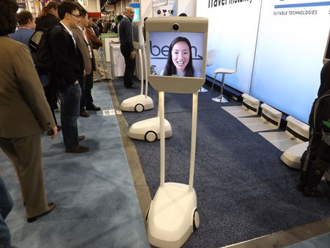
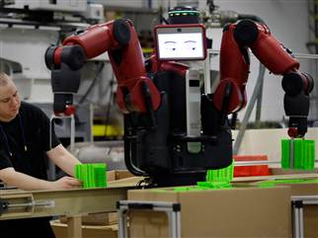
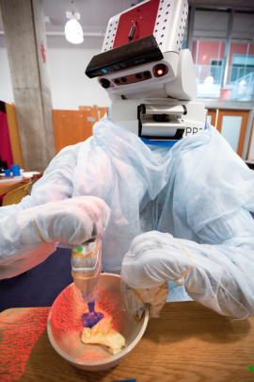
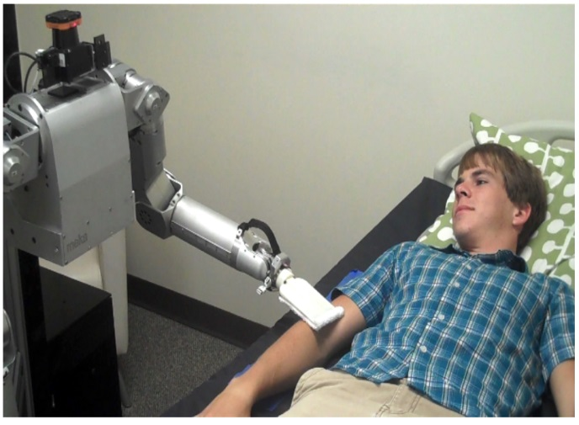
Structured To Unstructured Environments
Kuka arm
Kiva
Beam
Baxter
PR2
Robot Nurse
[Images from Google]

Slide 4
Path Planning
High DoF manipulators
Continuous high dimensional space
Obstacles
End-Effector
B
A
Geometric criteria's
Collision free
Shortest path
Least time
Minimum energy
Joint
Link
Kavraki et. al. PRM
LaValle et. al. RRT
Ratliff et. al. CHOMP
Karaman et. al. RRT*
Schulman et. al. TrajOpt
BASE
7 DoF arm
Notes:
A necessary capability for every robot is to plan paths. So consider a 7 dof arm, it has links joints and an end-effector with
Which it interacts with the world.

Slide 5
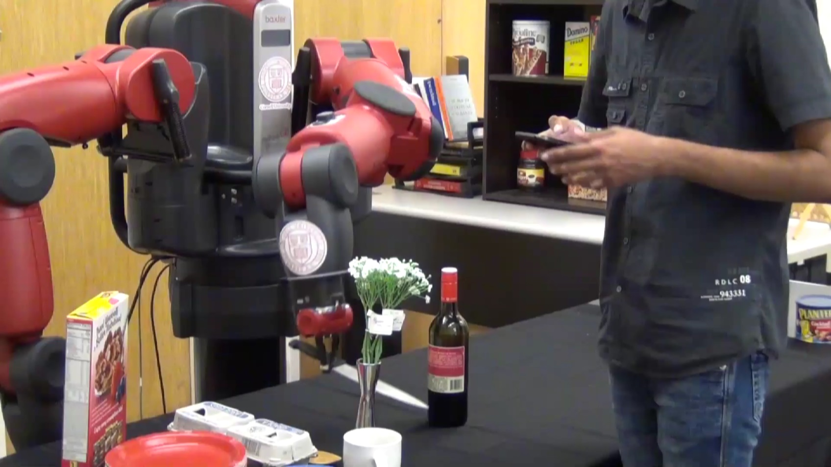
Context Rich Environment

Slide 6
Context Rich Environment
http://www.youtube.com/watch?v=uLktpkd7ojA
Video [14 sec to 18 sec]

Slide 7
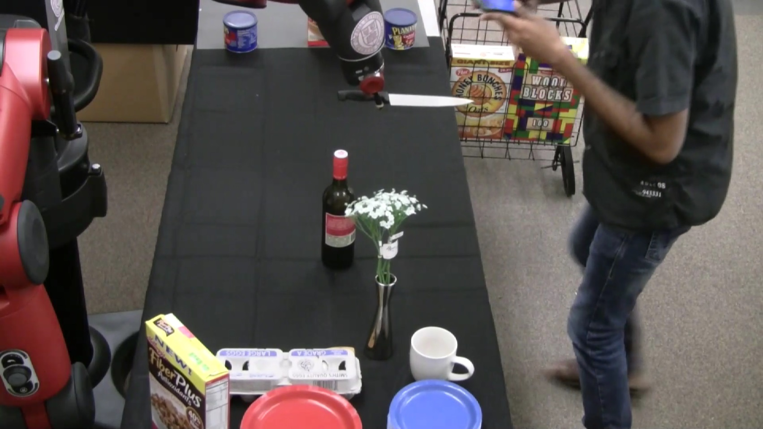
What went wrong?
Robot not modeling the context
Does not understand the preferences
Notes:
So what we just saw is an example when robot simply follows a geometric approach to path planning
It does not understand the preferences because it is not modeling the context and the related preferences.

Slide 8
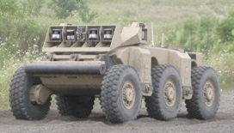
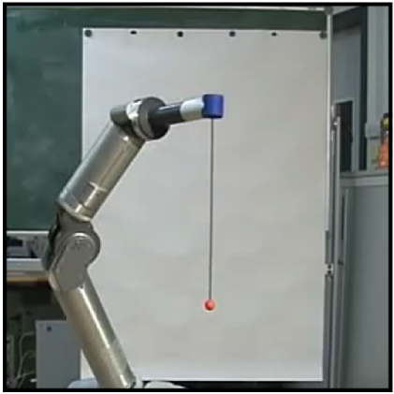
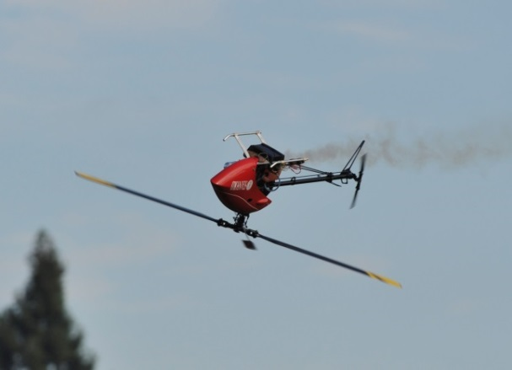
Does Existing Works Address This?
Inverse Reinforcement Learning
(Kober and Peters 2011 , Abbeel et. al. 2010 , Ziebrat et. al. 2008 , Ratliff et. al. 2006)
Context is not important, focuses on specific trajectory
Modeling human navigation patterns Kitani et. al. ECCV 2012
Optimal Demonstrations: Requires an expert
Ratliff et. al.
Kober et. al.
Abbeel et. al.
Notes:
So the next question is, can existing work help?
Answer is, apparently NOT!!!
Previous works on learning good trajectories has focused on specific trajectories for a specific task.
Learning these trajectories is hard but there is no context and no notion of user preferences.
Because is most of the examples there is a single trajectory which is right.
Hence for learning they rely on a demonstration from a expert. So in case of helicopter an expert pilot will fly it for you.
This limits the applicability of these approaches in household setting where the user is typically non-expert.
But as many studies in HRI has shown giving such expert demonstrations is challenging on high DoF robots.

Slide 9
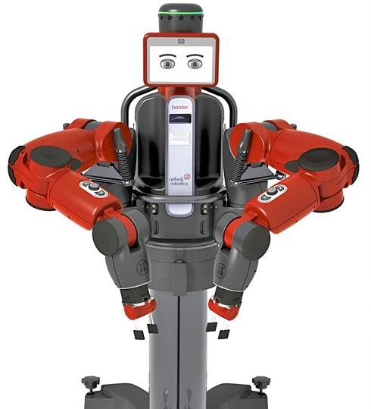
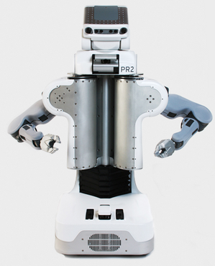
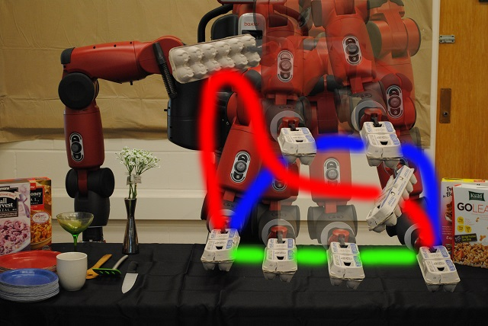
Our Goal
Model Context
Generate multiple trajectories for a task
User preferences
Learn from non-expert’s

Slide 10
Outline
Motivation
Approach
Context-based score
Feedback mechanism
Learning algorithm
Results

Slide 11
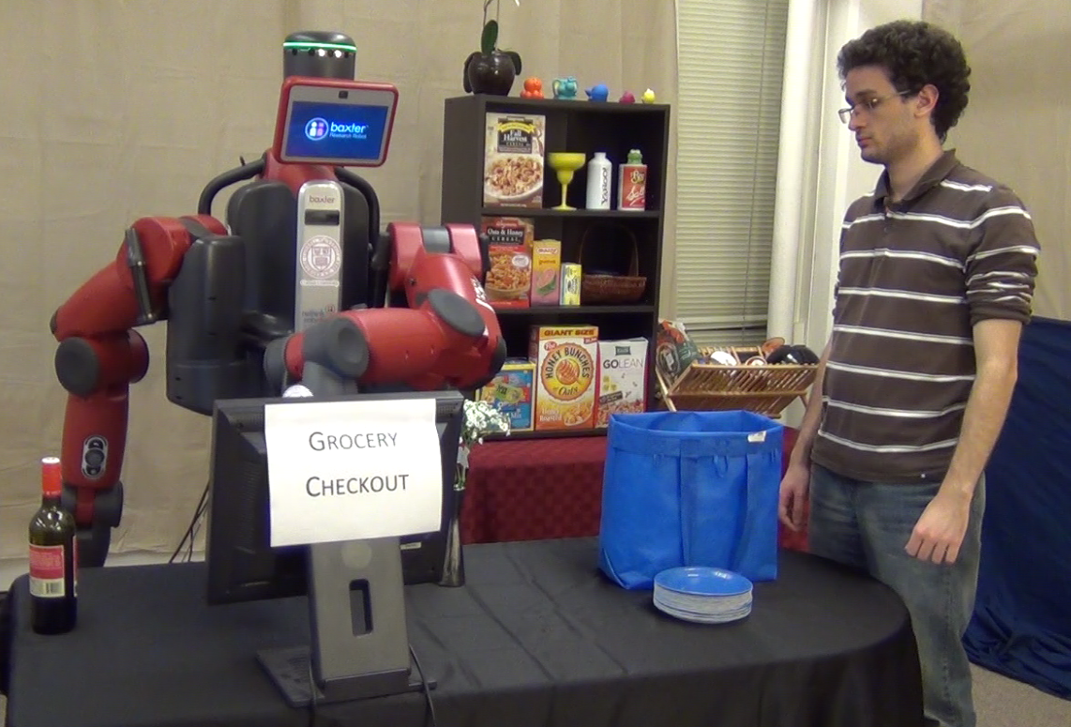
Learning Setting
$$s \left(y , context \right| task)$$
$$s^{∗}\left(y , context | task\right)$$
Robot
User
Goal: Learn user preferences
Online learning system
Learns from user feedback
Sub-optimal feedback

Slide 12
Outline
Motivation
Approach
Context-based score
Feedback mechanism
Learning algorithm
Results

Slide 13
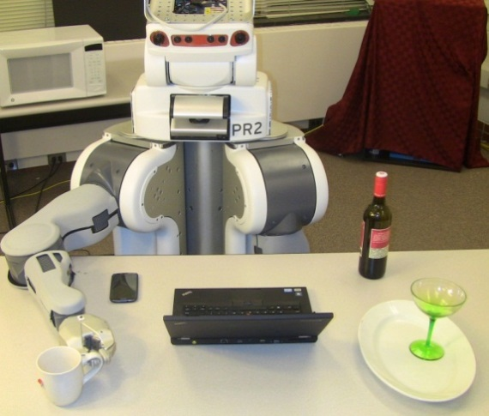
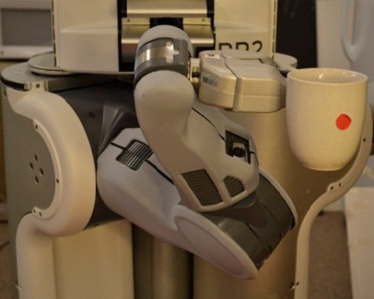
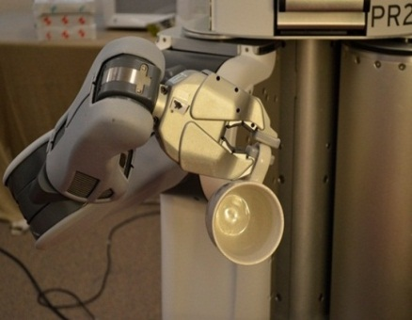
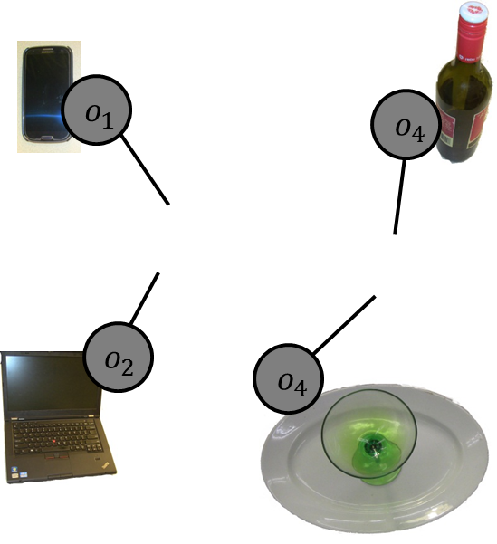
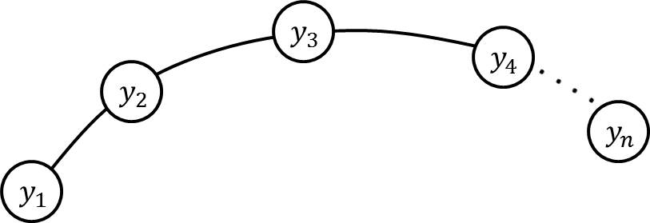
Example of Preferences
Move a glass of water
Contorted Arm
Upright
Preferences varies with users, tasks and environments
Context

Slide 14
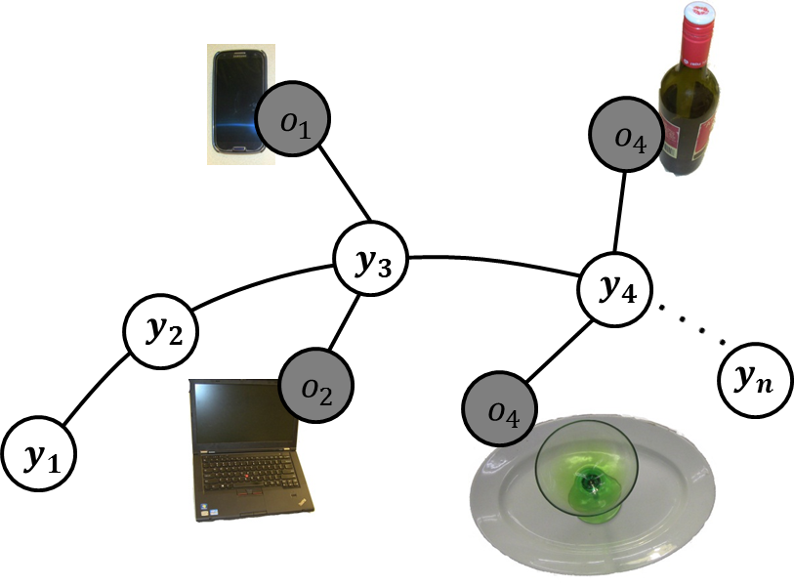
Score function
$s\left(x,y;w\right)=w_{O}^{T}φ_{O}\left(x,y\right)+w_{E}^{T}φ_{E}(x,y)$
Context
Trajectory
Object-object
Interactions
Robot configuration
and
Environment Interactions
Connecting waypoints to neighboring objects
Trajectory graph

Slide 15
Score function
Object attributes: {electronic, fragile, sharp, liquid, hot, …}
E.g. Laptop: {electronic, fragile}
Knife: {sharp} …..
Hermans et. al. ICRA w/s 2011
Koppula et. al. NIPS 2011
Object-object Interactions
$$w_{O}^{T}φ_{O}\left(x,y\right)$$
$$\sum_{edges}{ \sum_{l,k∈labels}{1\left(edge,l,k\right)w_{lk}^{T}φ_{o−o}(x,y;edge)}}$$
Trajectory graph
Distance features

Slide 16
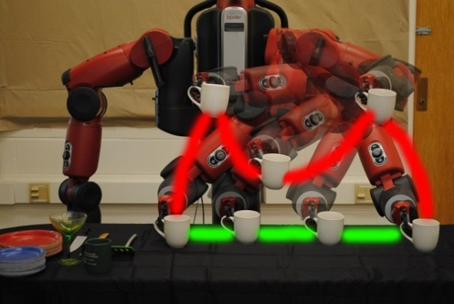
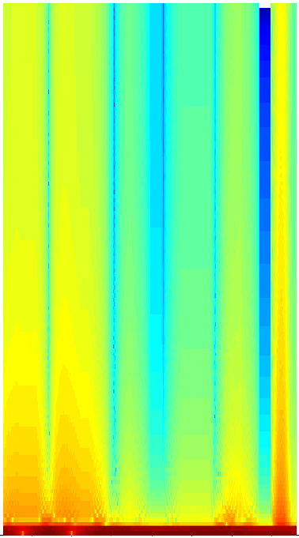
Score function
$s\left(x,y;w\right)=w_{O}^{T}φ_{O}\left(x,y\right)+w_{E}^{T}φ_{E}(x,y)$
$${∈ℝ}^{75}$$
Features
Spectrogram
Object’s distance from horizontal and vertical surfaces
Object’s angle with vertical axis
Robot’s wrist and elbow configuration in cylindrical co-ordinate
Object-object
Interactions
Robot configuration
and
Environment Interactions
Bad
Good
Cakmak et. al. IROS 2011

Slide 17
Outline
Motivation
Approach
Context-based score
Feedback mechanism
Learning algorithm
Results
Notes:
Now lets see how can the user interact with the robot.

Slide 18
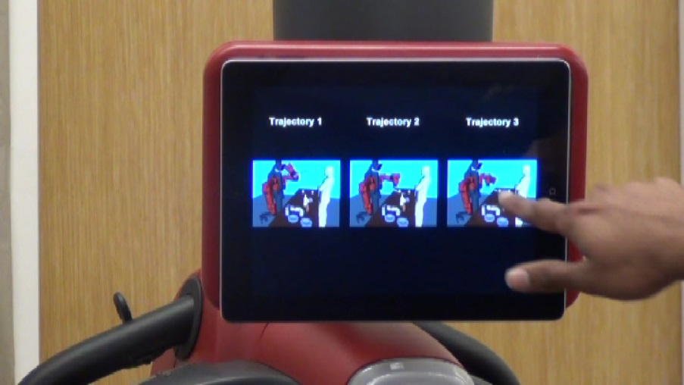
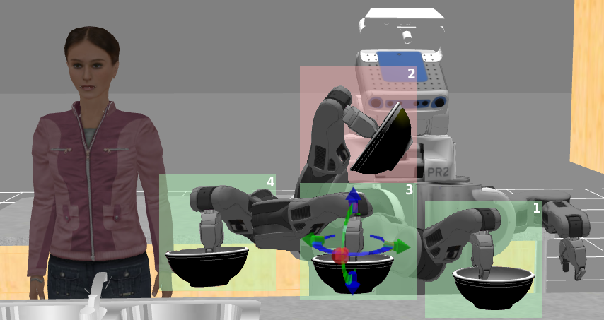
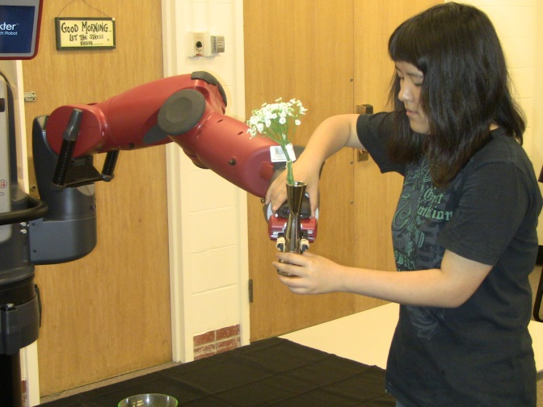
User Feedback
Intuitive feedback mechanisms
Re-rank
Interactive
Zero-G
Notes:
In our setting we want the feedback to be really easy. So as feedback user slightly improve the trajectory proposed by the robot.

Slide 19
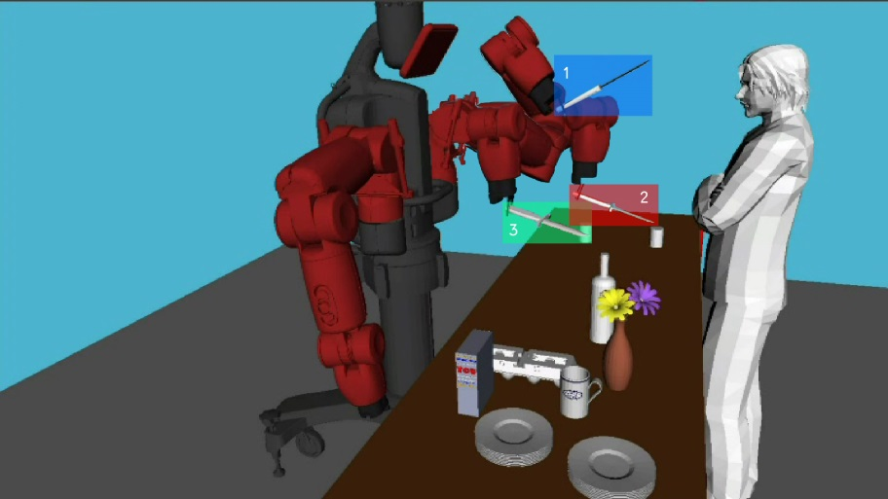
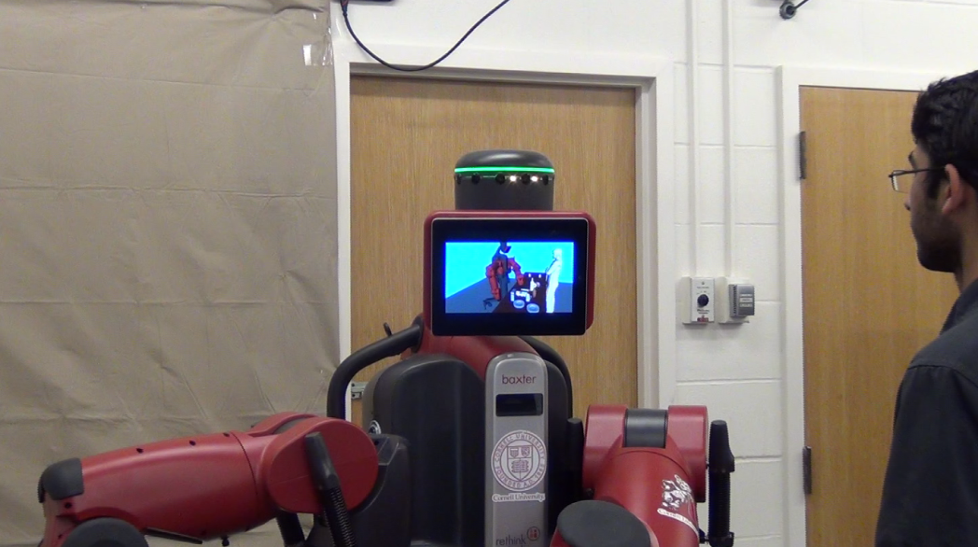
1. Re-rank
Robot ranks trajectories and user selects one
Top three trajectories
User feedback
User observing top three trajectories

Slide 20
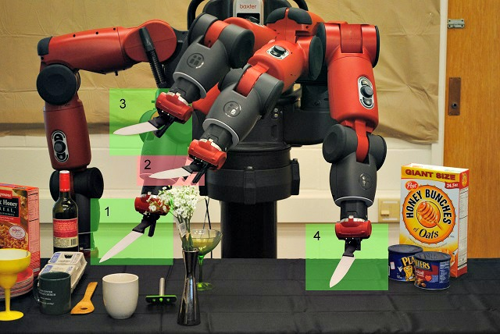
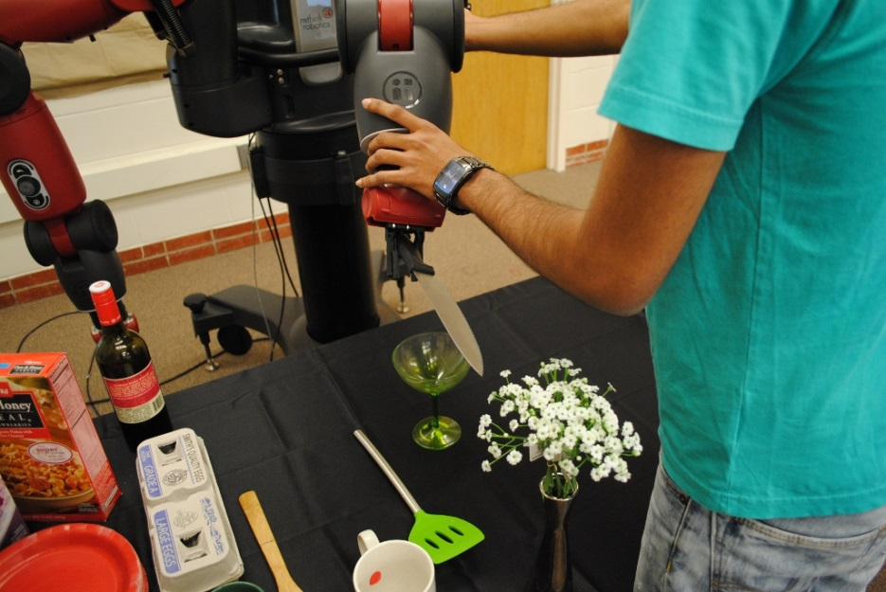
2. Zero-G
User corrects trajectory waypoints
Bad waypoint in red
Holding wrist activates zero-G mode
Notes:
v

Slide 21
2. Zero-G
User corrects trajectory waypoints
Bad waypoint in red
Holding wrist activates zero-G mode
Notes:
v

Slide 22
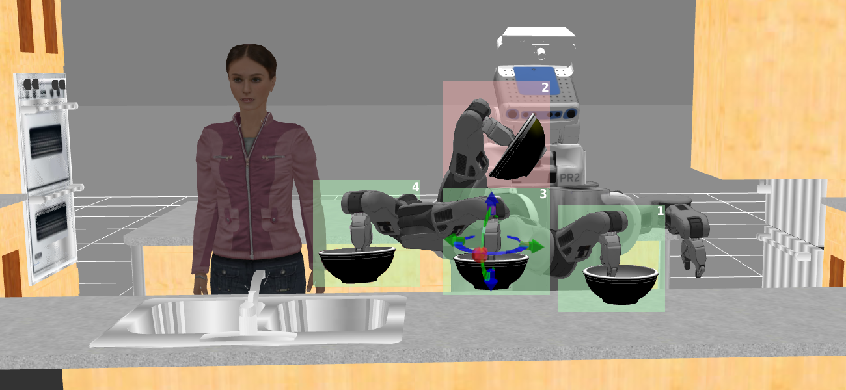
3. Interactive
Not all robots support zero-G feedback

Slide 23
3. Interactive
Not all robots support zero-G feedback

Slide 24
Outline
Motivation
Approach
Context-based score
Feedback mechanism
Learning algorithm
Results

Slide 25
Coactive Learning
$s\left(x , y;w\right)$ =
$$w^{T}φ(x,y)$$
$s^{∗}\left(x , y\right)$ =
$$w^{∗T}φ(x,y)$$
Robot
User
Goal: Learn user preferences
Learn from sub-optimal feedback
Shivaswamy & Joachims, ICML 2012

Slide 26
Trajectory Preference Perceptron
for $t=1 to T$
$Robot recieves a task x_{t}$
$$Sample trajectories y_{1},…, y_{n}$$
$y_{t}=argmax_{y_{t}}s(x,y;w_{t})$
$Observes feedback {\overline{y}}_{t}$
$w_{t+1}←w_{t}+φ\left(x,\overline{y_{t}}\right)−φ\left(x,y_{t}\right)$
end
Regret bound
$$E\left[REG_{T}\right]≤O\left(\frac{1}{α\sqrt{T}}+\frac{1}{T}∑ξ_{t}\right)$$
Shivaswamy & Joachims, ICML 2012

Slide 27
Outline
Motivation
Approach
Context-based score
Feedback mechanism
Learning algorithm
Results

Slide 28
Experimental Setup
Two robots: Baxter and PR2
35 tasks in household setting
2100 expert labeled trajectories
16 tasks in grocery store checkout settings
1300 expert labeled trajectories
14 objects
Bowl, Knife, Laptop, Metal box, Fruits, Egg cartons etc.
7 users

Slide 29
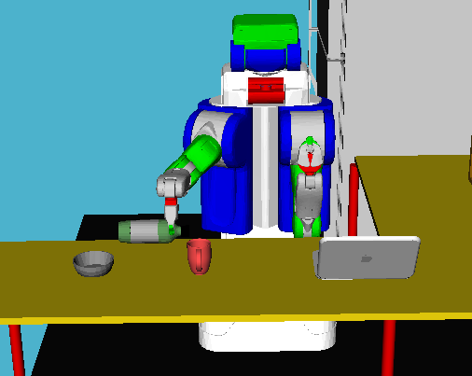
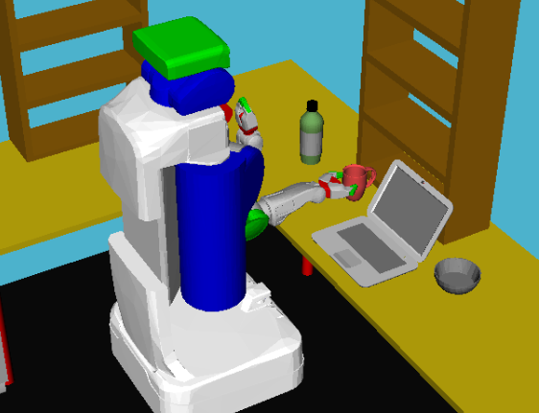
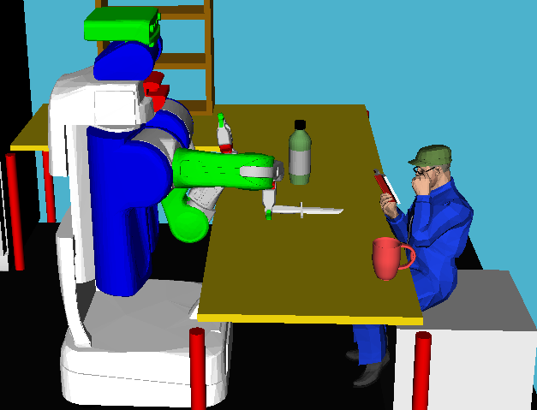
Experimental Setting 1
Household environment on PR2
Pouring
Cleaning the table
Setting up table
35 tasks
Variation in objects and environment
Expert’s label on 2100 trajectories on a scale of 1 to 5

Slide 30
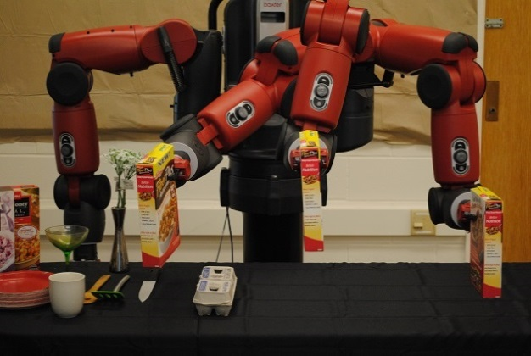
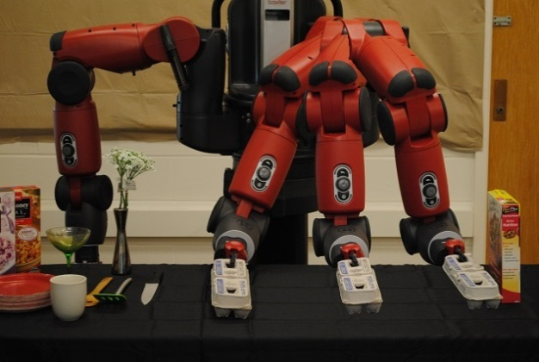
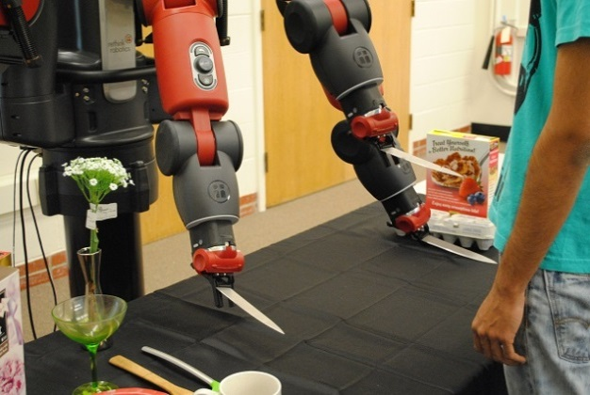
Experimental Setting 2
Grocery store checkout on Baxter
Cereal box
Egg carton
Knife in human vicinity
16 tasks
Variations in objects and their placement
Expert’s label on 1300 trajectories on a scale of 1 to 5

Slide 31
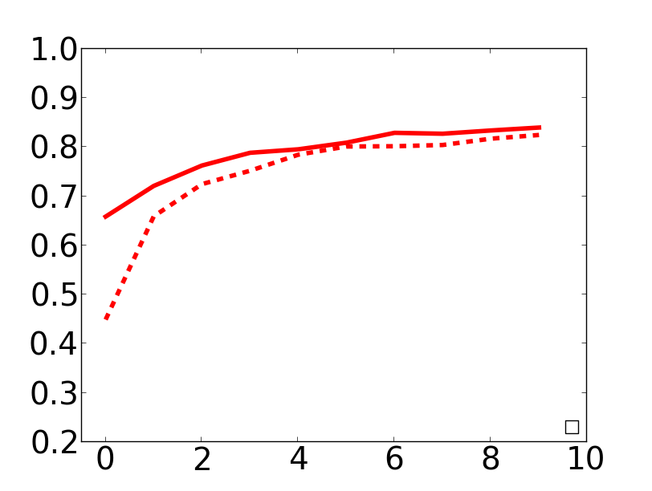
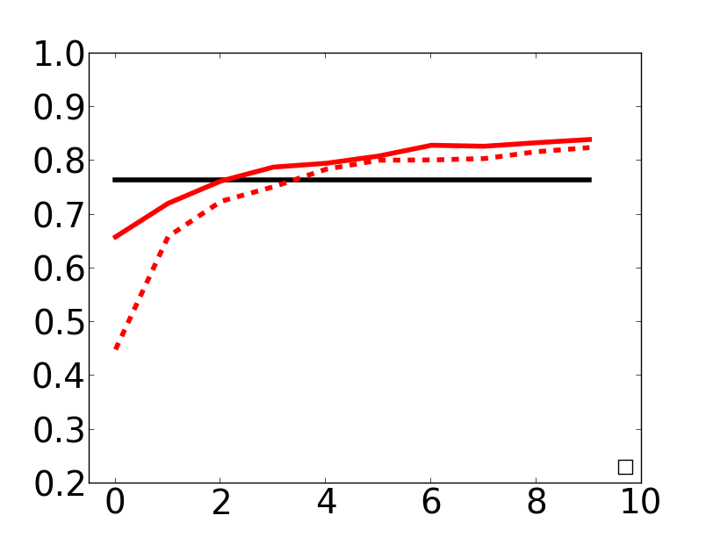
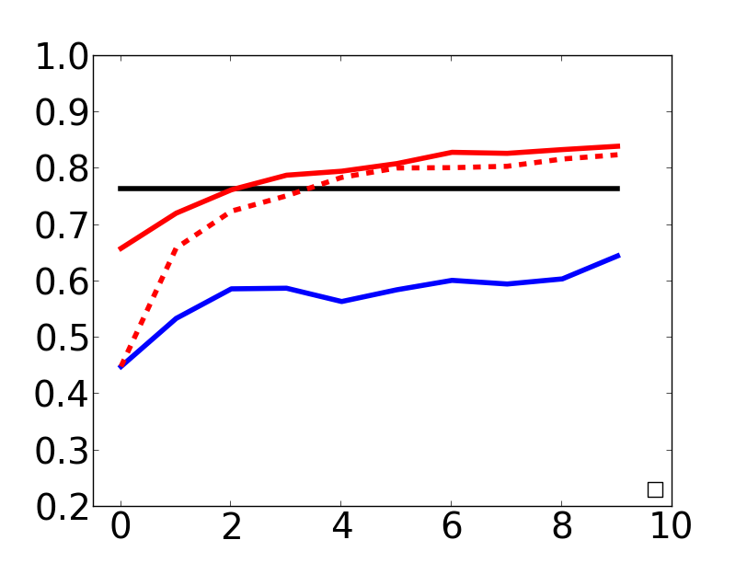
Generalization
Household setting
Testing on a new environment
Higher nDCG w/o feedback
SVM-rank trained on expert’s labels
MMP-online is an IRL technique
Ours pre-trained
nDCG@3
SVM-rank
Ours w/o pre-training
MMP-online
#Feedback

Slide 32
User Study
10 tasks per user
7 users
Total 7 hours worth robot interaction
Users interacts until satisfied

Slide 33
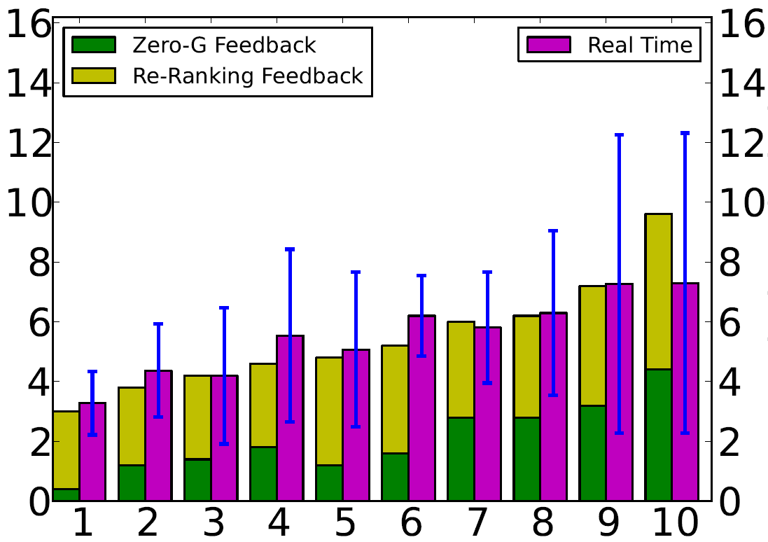
User Study
Grocery setting
Baxter
Re-rank popular for easier tasks
Increase in zero-G for hard tasks
Time
#Feedback
Re-rank
#Feedback
Time (min)
Task No.
Zero-G
Increasing
difficulty

Slide 34
User Study
User | # Re-rank | # Zero-G | Time (min) | Self Score | Cross Score
1 | 5.4 | 3.3 | 7.8 | 3.8 | 4.0
2 | 1.8 | 1.7 | 4.6 | 4.3 | 3.6
3 | 2.9 | 2.0 | 5.0 | 4.4 | 3.2
4 | 3.2 | 1.5 | 5.3 | 3.0 | 3.7
5 | 3.6 | 1.9 | 5.0 | 3.5 | 3.3
6 | 3.1 | 2.4 | - | 3.5 | 3.6
7 | 2.3 | 1.8 | - | 4.1 | 4.1
Avg.
3.2 (1.1) | 2.1 (0.6) | 5.5 (1.3) | 3.8 (0.5) | 3.6 (0.3)

Slide 35
User Study
User | # Re-rank | # Zero-G | Time (min) | Self Score | Cross Score
1 | 5.4 | 3.3 | 7.8 | 3.8 | 4.0
2 | 1.8 | 1.7 | 4.6 | 4.3 | 3.6
3 | 2.9 | 2.0 | 5.0 | 4.4 | 3.2
4 | 3.2 | 1.5 | 5.3 | 3.0 | 3.7
5 | 3.6 | 1.9 | 5.0 | 3.5 | 3.3
6 | 3.1 | 2.4 | - | 3.5 | 3.6
7 | 2.3 | 1.8 | - | 4.1 | 4.1
5 Feedback
3 Re-rank
2 Zero-G
Avg.
3.2 (1.1) | 2.1 (0.6) | 5.5 (1.3) | 3.8 (0.5) | 3.6 (0.3)

Slide 36
User Study
User | # Re-rank | # Zero-G | Time (min) | Self Score | Cross Score
1 | 5.4 | 3.3 | 7.8 | 3.8 | 4.0
2 | 1.8 | 1.7 | 4.6 | 4.3 | 3.6
3 | 2.9 | 2.0 | 5.0 | 4.4 | 3.2
4 | 3.2 | 1.5 | 5.3 | 3.0 | 3.7
5 | 3.6 | 1.9 | 5.0 | 3.5 | 3.3
6 | 3.1 | 2.4 | - | 3.5 | 3.6
7 | 2.3 | 1.8 | - | 4.1 | 4.1
5 to 6 min. per task
Avg.
3.2 (1.1) | 2.1 (0.6) | 5.5 (1.3) | 3.8 (0.5) | 3.6 (0.3)

Slide 37
User Study
User | # Re-rank | # Zero-G | Time (min) | Self Score | Cross Score
1 | 5.4 | 3.3 | 7.8 | 3.8 | 4.0
2 | 1.8 | 1.7 | 4.6 | 4.3 | 3.6
3 | 2.9 | 2.0 | 5.0 | 4.4 | 3.2
4 | 3.2 | 1.5 | 5.3 | 3.0 | 3.7
5 | 3.6 | 1.9 | 5.0 | 3.5 | 3.3
6 | 3.1 | 2.4 | - | 3.5 | 3.6
7 | 2.3 | 1.8 | - | 4.1 | 4.1
Similar preferences
Avg.
3.2 (1.1) | 2.1 (0.6) | 5.5 (1.3) | 3.8 (0.5) | 3.6 (0.3)

Slide 38
Robot Demonstration
http://www.youtube.com/watch?v=uLktpkd7ojA
Video [full video]

Slide 39
Conclusion
Challenges of Unstructured Environment
Geometric approaches are not enough
Modeling context is crucial
Learning from users and not expert’s

Slide 40
Thank You
For more details visit
http://pr.cs.cornell.edu/coactive

